Slide 1

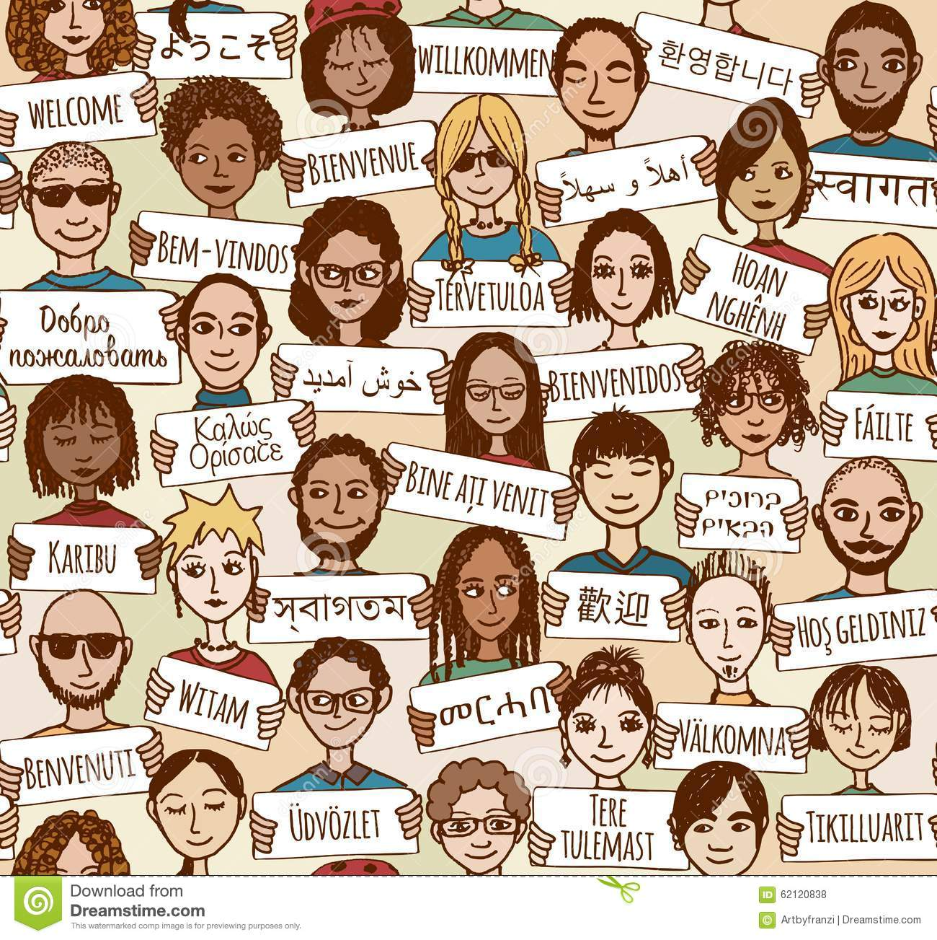
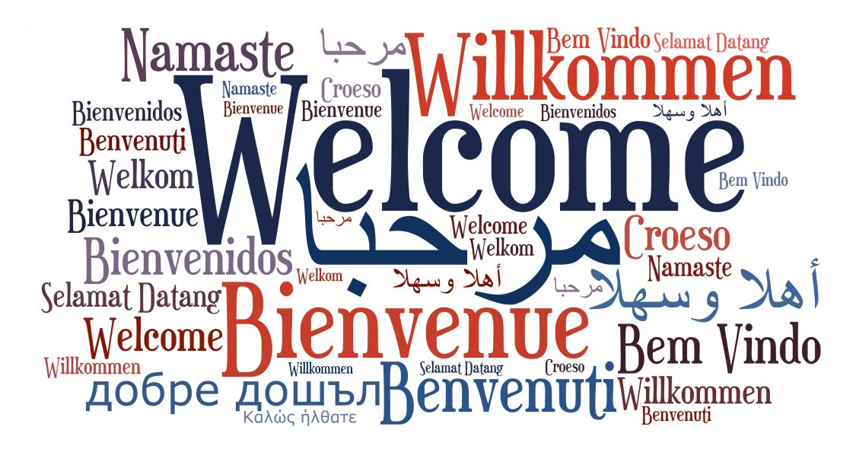
COMPSCI 326
Lecture 07: JavaScript DOM Events

Slide 2
Resources
MDN Web Docs
Introduction to Events
Event Reference
Event Interface
EventTarget Interface
EventTarget.addEventListener()
Event.preventDefault()
You can also learn more by watching this:
What are event listeners in JavaScript?, mmtuts

Slide 3
Today
GOAL (in-class exercise): make a web interface for the decoder functions.
We will be using HTML, scripts, the DOM (Document Object Model), and browser events to do this.

Slide 4
Jamboard
We saw a version of the application on the right last time.
In this version we will programmatically connect events to event listeners/handlers that will perform an action given an event that occurred.

Slide 5
Version 1
Let’s take a look at where we left off with this version of the application last time.

Slide 6
Version 2
In version 2, we are not making any changes to the interface. But, we will make some changes to the code to tidy things up a bit.

Slide 7
Version 3
In version 3, we will get rid of the button and make the app a little more interactive!

